Slide 1
Computing Basics for Bioinformatics on the Cloud
Session 2
Yaoyu Wang
Notes:
Unix/Cloud Basics/IGV installation

Slide 2
Overview
Introduction to cloud computing
Get on to the cloud
Get around on the cloud with linux
Free bioinformatics resources on the cloud
Download slide at:
http://tinyurl.com/cccbtrain

Slide 3
What is Cloud Computing?
Cloud Computing is a general term used to describe a network based computing that takes place over the Internet
Notes:
In other words, this is a collection/group of integrated and networked hardware, software and Internet infrastructure (called a platform).
Using the Internet for communication and transport provides hardware, software and networking services to clients.
These platforms hide the complexity and details of the underlying infrastructure from users and applications by providing very simple graphical interface or API (Applications Programming Interface).

Slide 4

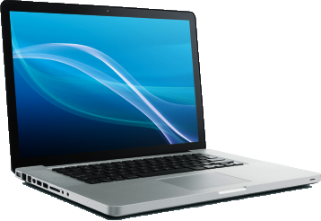
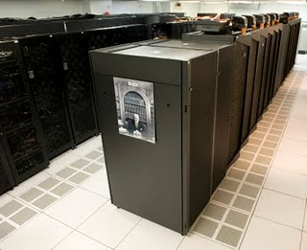
Overly Simplistic Cloud Computing Schema
Internet

Slide 5
Basic Cloud Characteristics
The “flexibility and elasticity” allows these systems to scale up and down at will – utilising the resources of all kinds (CPU, storage, server capacity, load balancing, and databases).
The “pay as much as used and needed” type of utility computing and the “always on!, anywhere and any place” type of network-based computing.
The “no-need-to-know” in terms of the underlying details of infrastructure, applications interface with the infrastructure via the APIs.

Slide 6



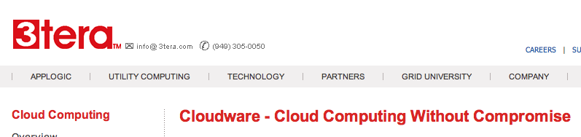






Some Commercial Cloud Offerings
Notes:
Problem: Commercial offerings are proprietary and usually not open for cloud systems research and development

Slide 7
Amazon Web Services
Elastic Compute Cloud (EC2)
Rent computing resources by the hour
Basic unit of accounting = instance-hour
Additional costs for bandwidth
Elastic Block Storage (EBS)
Persistent storage
Charge by provision block
Additional costs for bandwidth

Slide 8
Cloud Computing
Quick-start an Amazon EC2 instance…

Slide 9
Cloud Computing
Running a server on Amazon Web Service (AWS) requires you to go through the following steps:
Create your account on Amazon (if you do not already have one) and setup your credentials
Install Amazon EC2 API Tools
Instantiate your image (i.e. your account)
Configure your instance (i.e. your virtual machine)

Slide 10
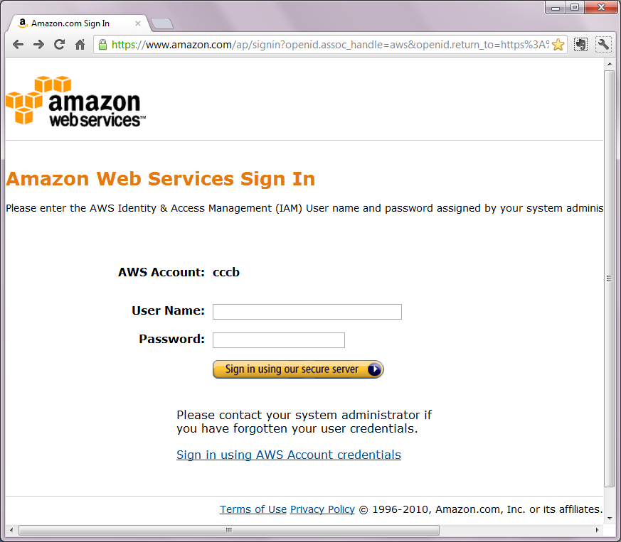
Cloud Computing: Start the Machine

Slide 11
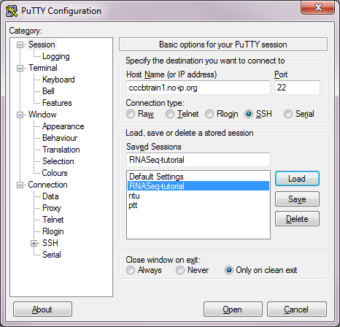
Cloud Computing: Logging in
For Windows
Download PuTTY at: http://tinyurl.com/putty-d
cccbtrain1.no-ip.org
22
Save Session
Launch!

Slide 12
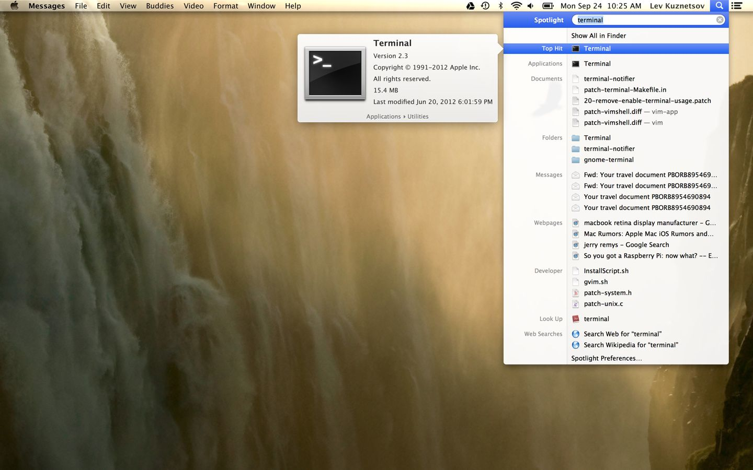
Cloud Computing: Logging in
For Mac
You already have the necessary program pre-installed

Slide 13
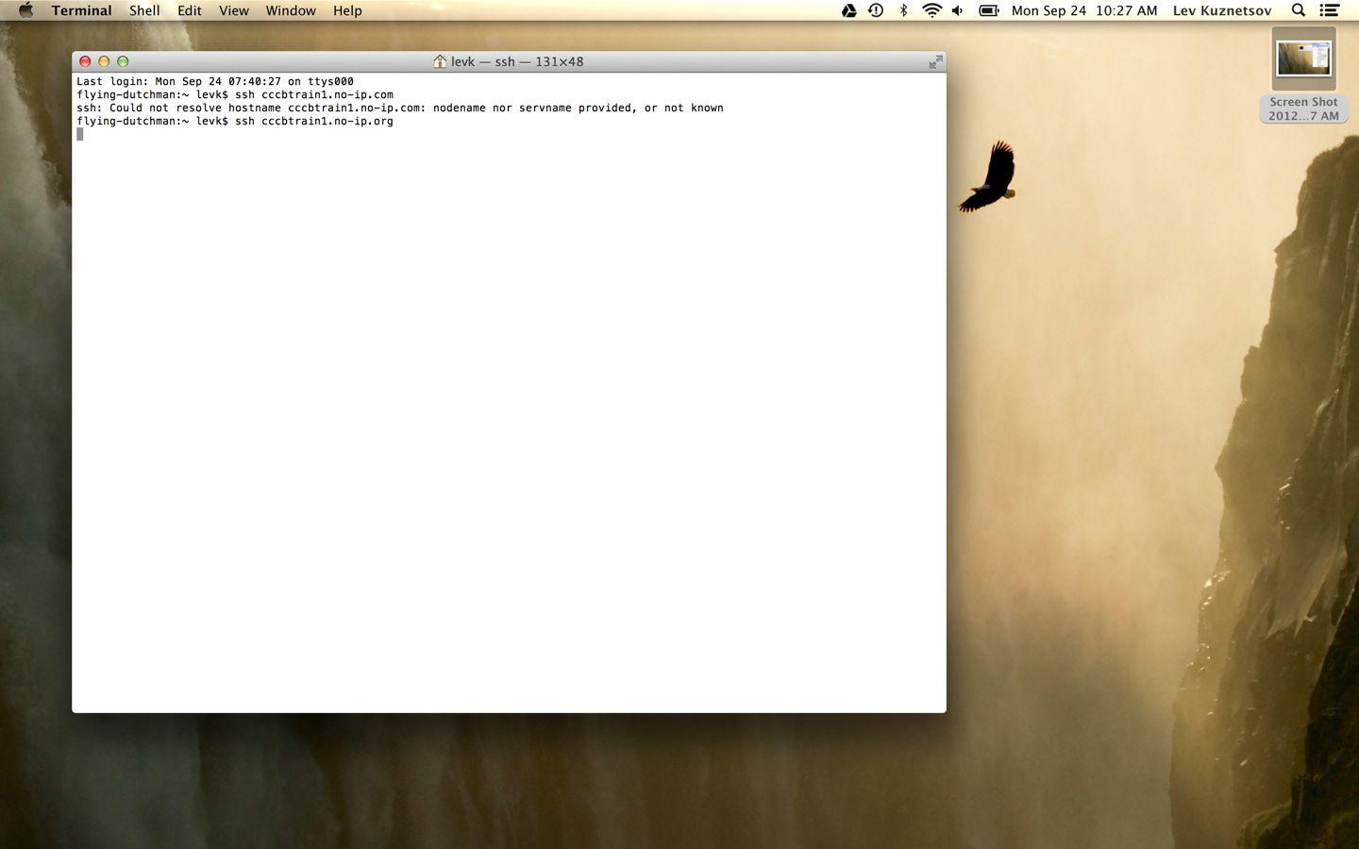
Cloud Computing: Logging in
For Mac
You already have the necessary program pre-installed
ssh cccbtrain1.no-ip.org

Slide 14
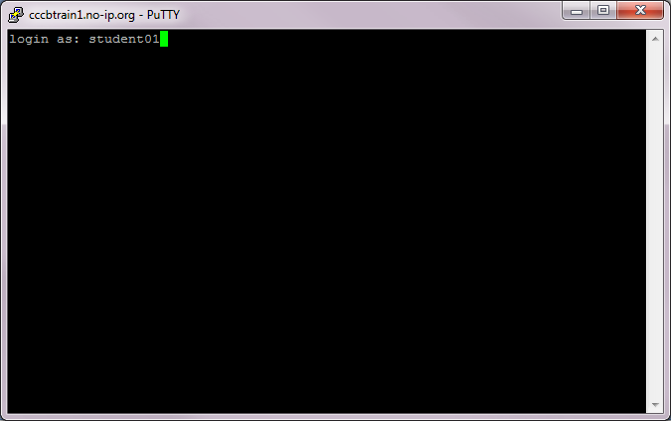
Cloud Computing: Logging in
Now you are on THE Cloud…
UID: student01

Slide 15
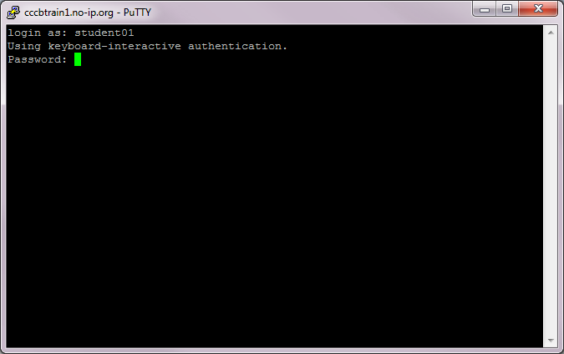
Cloud Computing: Logging in
Now you are on THE Cloud…
UID: student01
Pwd: Foo123qaz

Slide 16
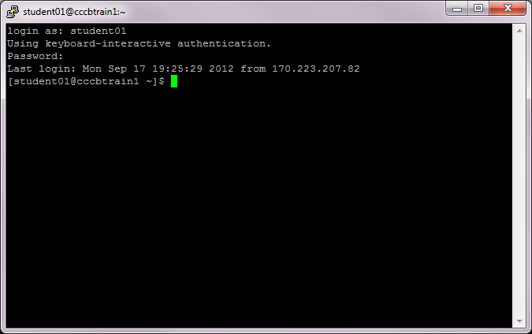
Cloud Computing: Logging in
Now you are on THE Cloud…
The “prompt”
The current directory (“path”)
The host
The User

Slide 17
Cloud Computing
How to navigate around the Cloud?
(a.k.a Linux Basics )

Slide 18
What exactly is a “shell”?
After logging in, Linux/Unix starts another program called the shell
The shell interprets commands the user types and manages their execution
The shell communicates with the internal part of the operating system called the kernel
The most popular shells are: tcsh, csh, korn, and bash
The differences are most times subtle
For this tutorial, we are using bash
Shell commands are CASE SENSITIVE!

Slide 19
File System Organization
/
/apps
/bin
/students
/home
/etc
student01
bowtie-0.12.8
student02
bwa-0.6.2
student03
chr17_reference
Path: /students/student01
student04
cufflinks-2.0.2
student25

Slide 20
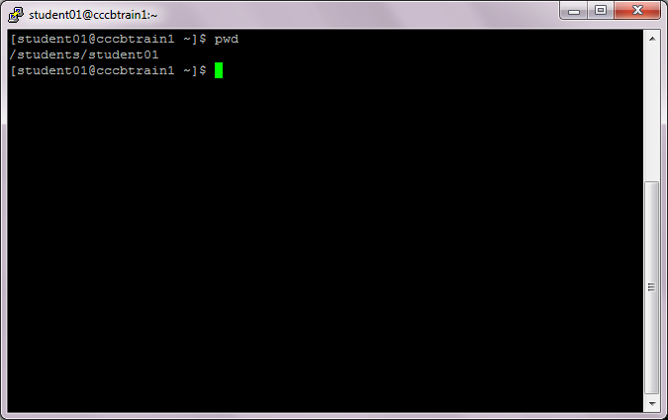
Basic Linux Command
pwd - print name of current/working directory

Slide 21
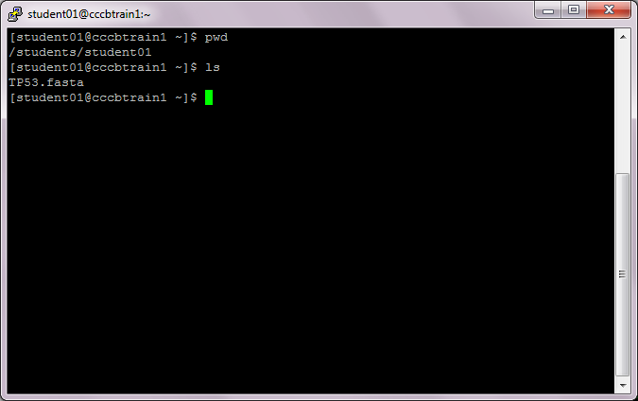
Basic Linux Command
ls - list directory contents

Slide 22
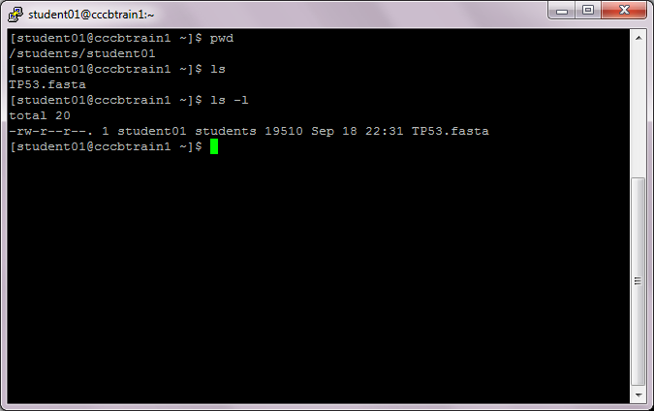
Basic Linux Command
ls –l use a long listing format

Slide 23
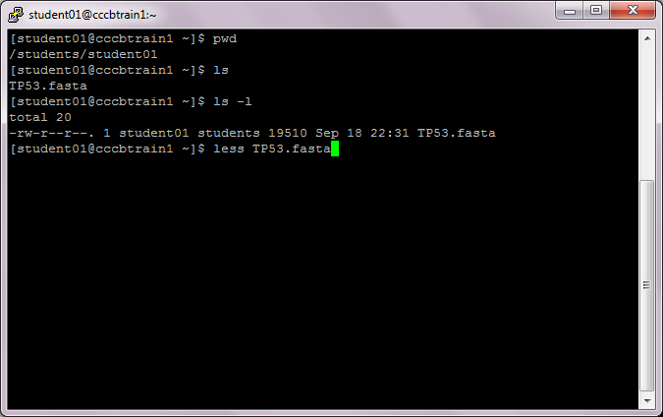
Basic Linux Command
less – quick file viewer

Slide 24
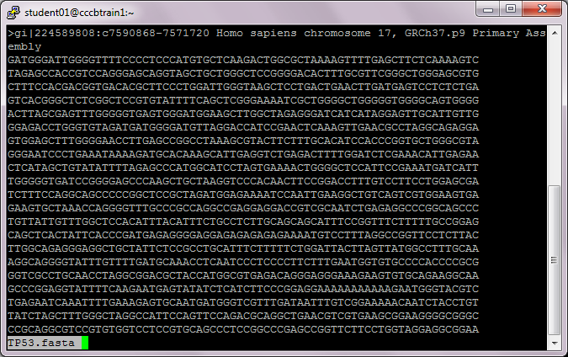
Basic Linux Command

Slide 25
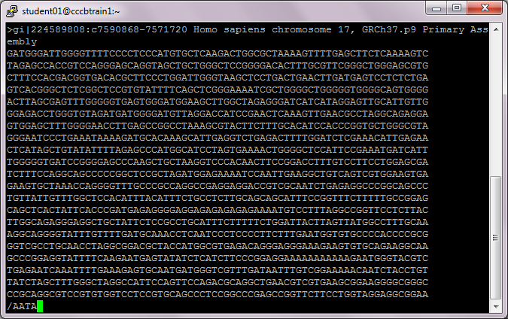
Basic Linux Commands
less – allows for simple text searching

Slide 26
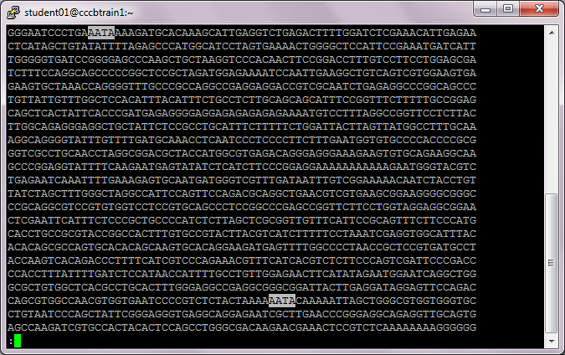
Basic Linux Command
less – allows for simple text searching

Slide 27
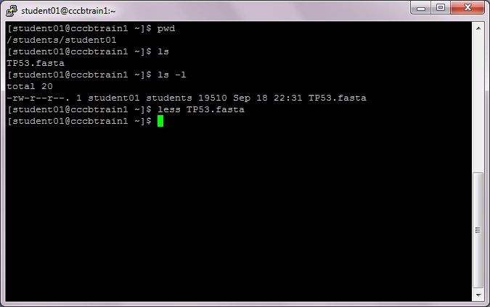
Basic Linux Command

Slide 28
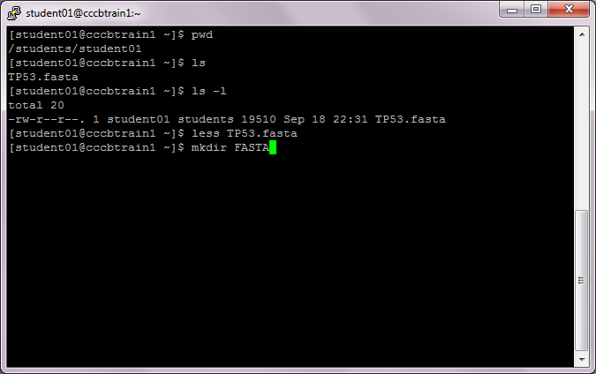
Basic Linux Command
mkdir – make directories

Slide 29
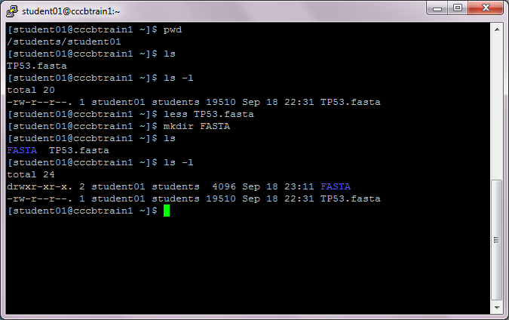
Basic Linux Command
mkdir – make directories

Slide 30
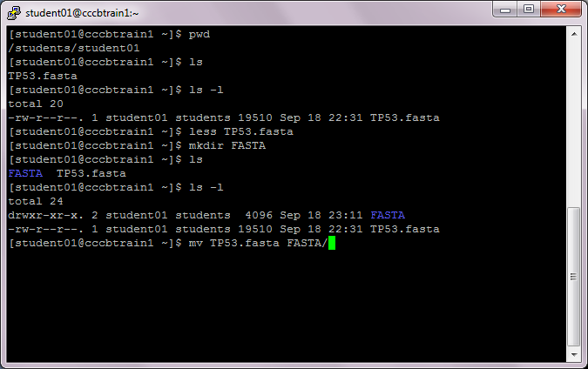
Basic Linux Command

Slide 31
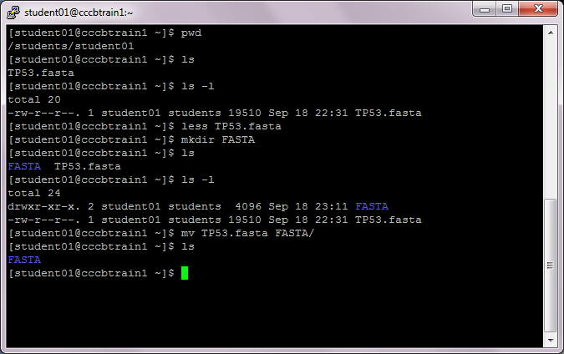
Basic Linux Command

Slide 32
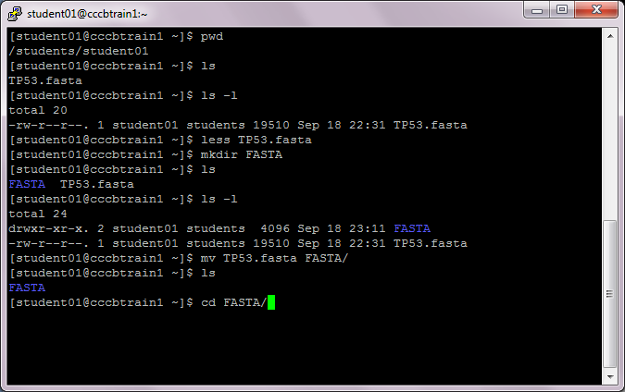
Basic Linux Command

Slide 33
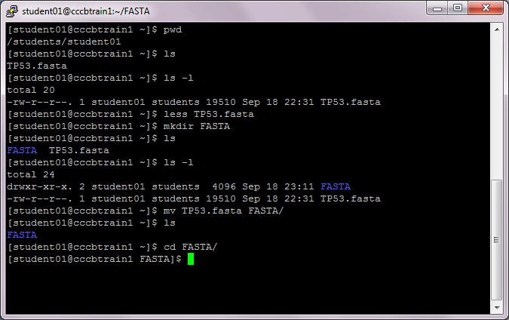
Basic Linux Command

Slide 34
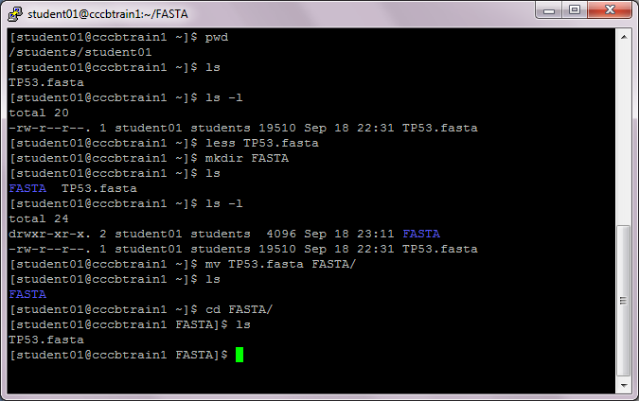
Basic Linux Command

Slide 35
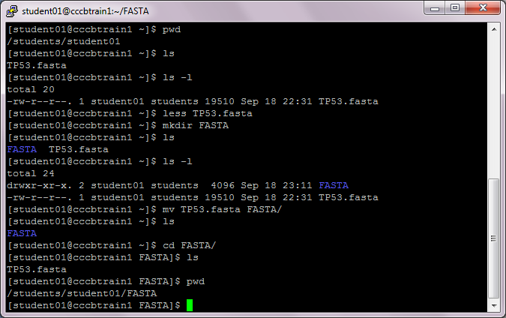
Basic Linux Command

Slide 36
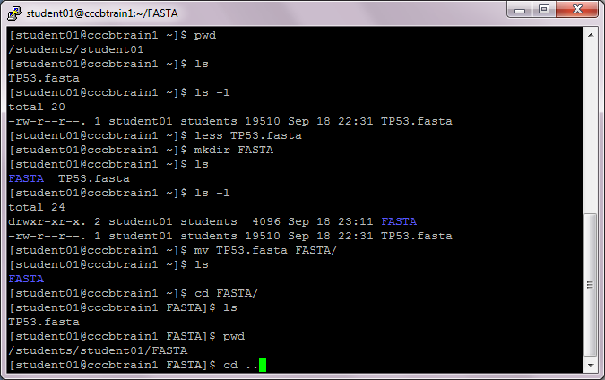
Basic Linux Command

Slide 37
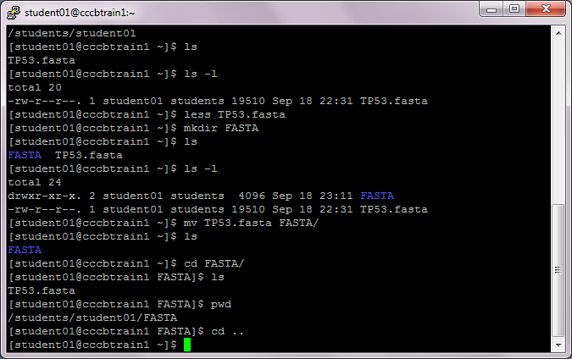
Basic Linux Command

Slide 38
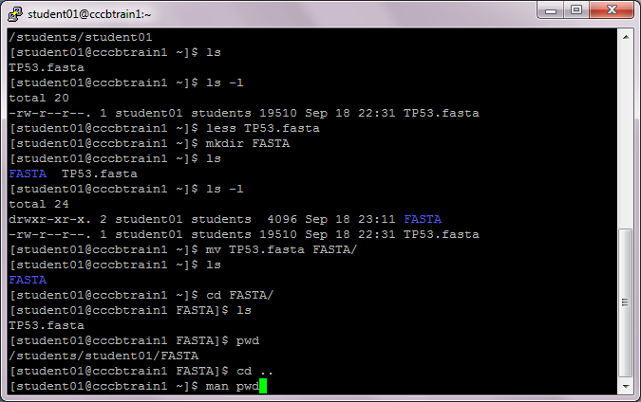
Basic Linux Command

Slide 39
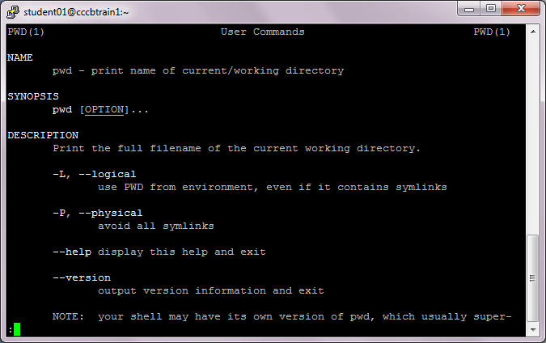
Basic Linux Command

Slide 40
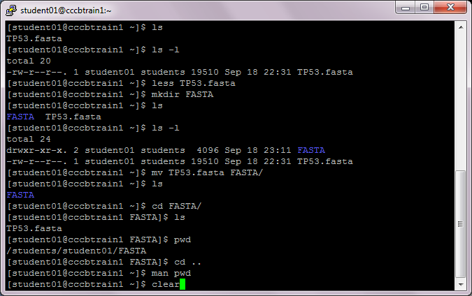
Basic Linux Command

Slide 41
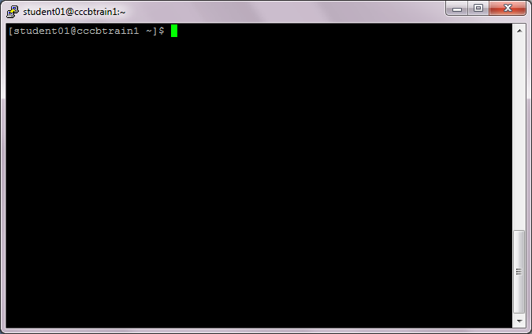
Basic Linux Command

Slide 42
Cloud Computing
How to get files up and down the Cloud?

Slide 43
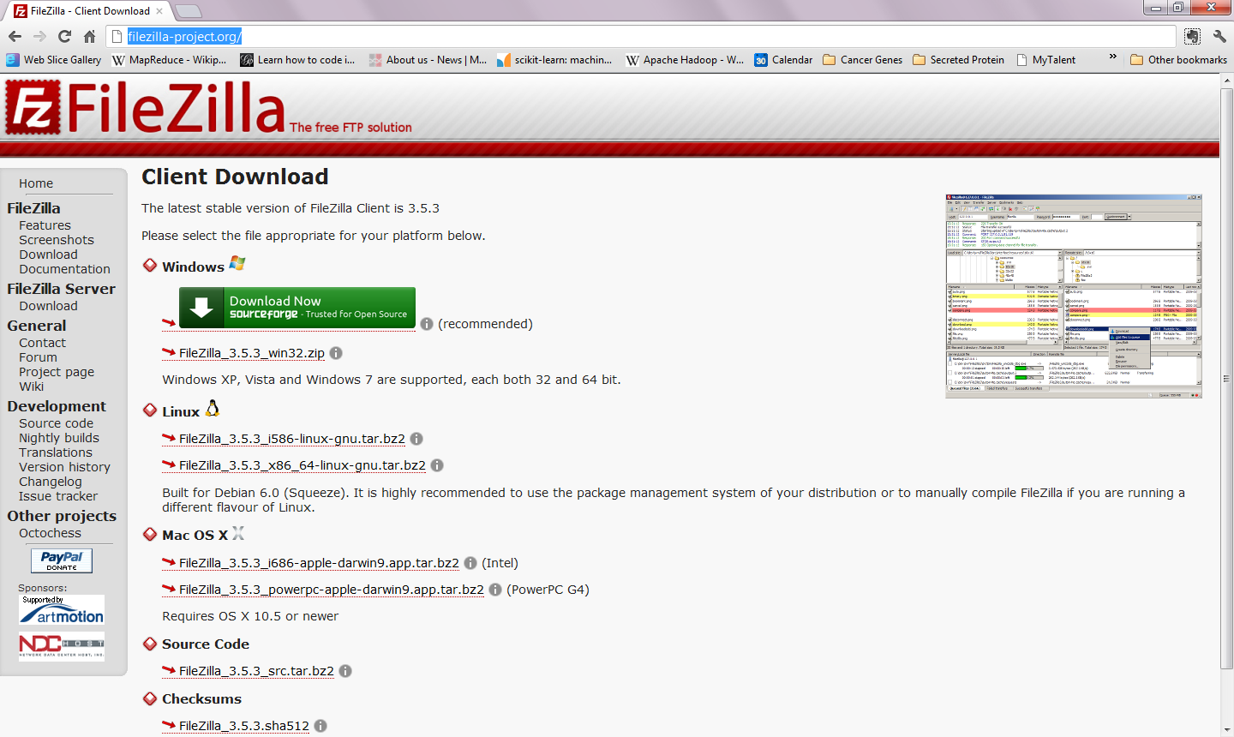
How to get files up and down the Cloud?
Download FileZilla at: http://filezilla-project.org/

Slide 44
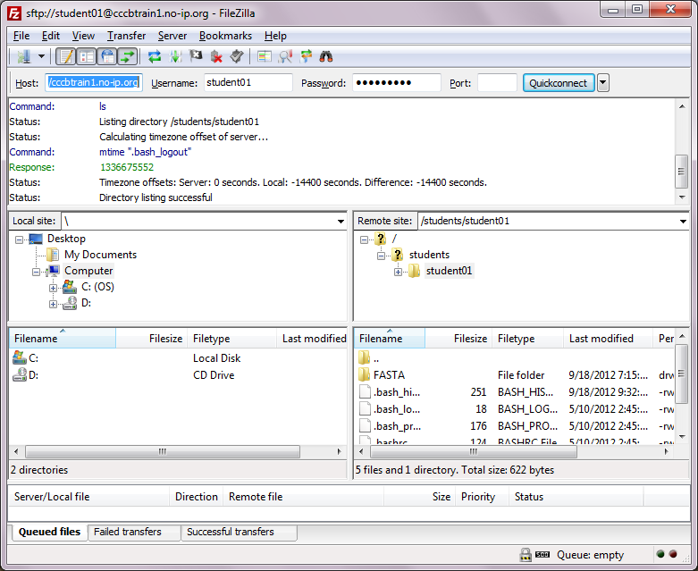
File Transfer with FileZilla
sftp://cccbtrain1.no-ip.org
Foo123qaz
student01
Local path
Remote path
Remote dir/files

Slide 45
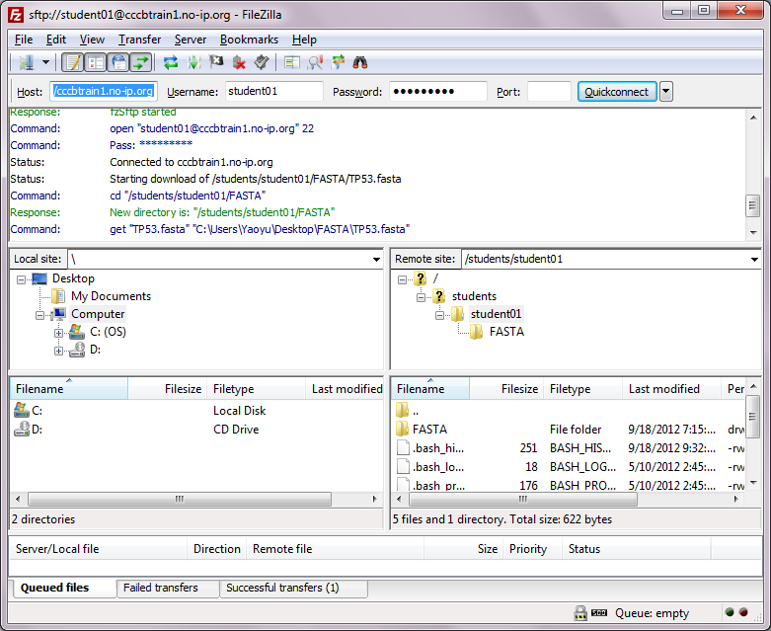
File Transfer with FileZilla
FASTA transferred

Slide 46
Session Summary
Could Computing are remotely hosted computational resources and ubiquitous accessible by internet
Amazon Web Service (AWS) and Elastic Compute Cloud (EC2) provides cloud computing service and storage by demand
Linux-based Cloud servers can be accessed through SSH (Secure SHell) by PuTTy
Files can be transferred up and down the Cloud Server by SFTP using programs such as FileZilla

Slide 47
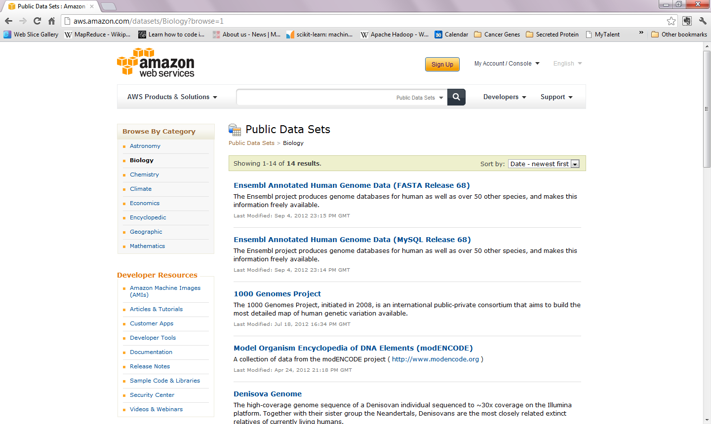
Public Available Data Resources on AWS
URL: http://aws.amazon.com/Dataset/Biology?browse=1

Slide 48
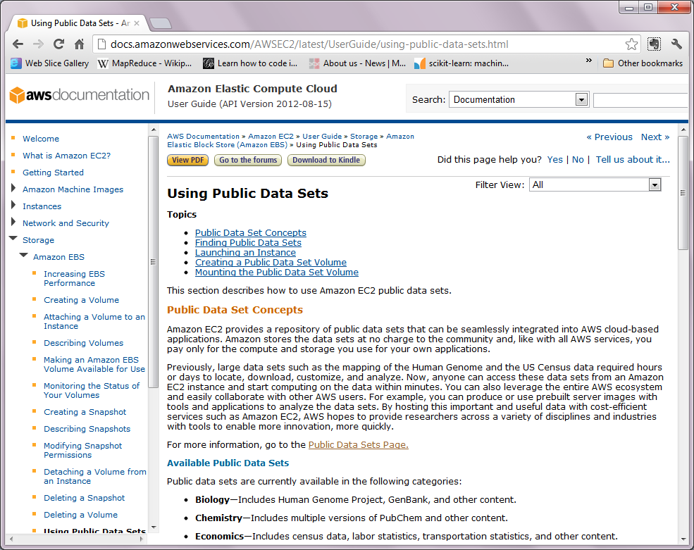
Available Data Resources on AWS

